Slide 1


Harry
http://dubbo.incubator.apache.org/en-us/
PPT模板下载：www.1ppt.com/moban/ 行业PPT模板：www.1ppt.com/hangye/
节日PPT模板：www.1ppt.com/jieri/ PPT素材下载：www.1ppt.com/sucai/
PPT背景图片：www.1ppt.com/beijing/ PPT图表下载：www.1ppt.com/tubiao/
优秀PPT下载：www.1ppt.com/xiazai/ PPT教程： www.1ppt.com/powerpoint/
Word教程： www.1ppt.com/word/ Excel教程：www.1ppt.com/excel/
资料下载：www.1ppt.com/ziliao/ PPT课件下载：www.1ppt.com/kejian/
范文下载：www.1ppt.com/fanwen/ 试卷下载：www.1ppt.com/shiti/
教案下载：www.1ppt.com/jiaoan/ PPT论坛：www.1ppt.cn

Slide 2

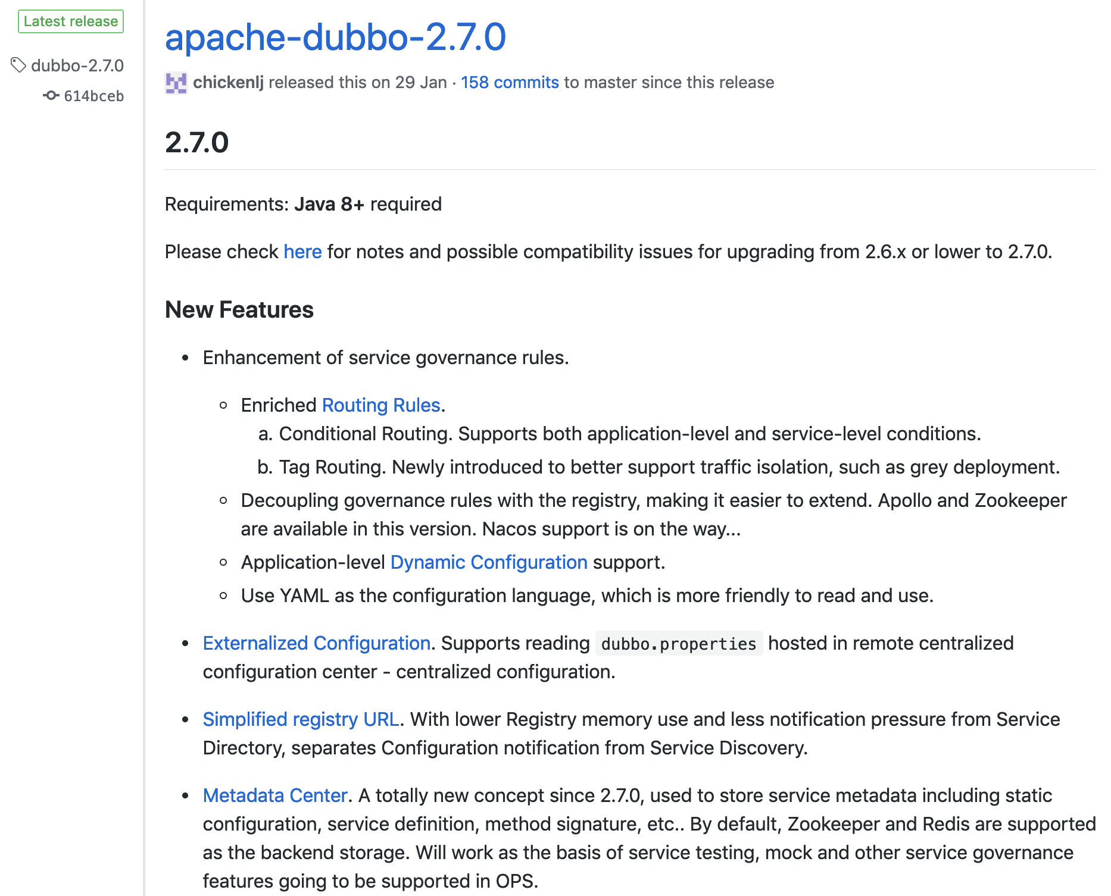
Apache Dubbo
PPT模板下载：www.1ppt.com/moban/ 行业PPT模板：www.1ppt.com/hangye/
节日PPT模板：www.1ppt.com/jieri/ PPT素材下载：www.1ppt.com/sucai/
PPT背景图片：www.1ppt.com/beijing/ PPT图表下载：www.1ppt.com/tubiao/
优秀PPT下载：www.1ppt.com/xiazai/ PPT教程： www.1ppt.com/powerpoint/
Word教程： www.1ppt.com/word/ Excel教程：www.1ppt.com/excel/
资料下载：www.1ppt.com/ziliao/ PPT课件下载：www.1ppt.com/kejian/
范文下载：www.1ppt.com/fanwen/ 试卷下载：www.1ppt.com/shiti/
教案下载：www.1ppt.com/jiaoan/ PPT论坛：www.1ppt.cn

Slide 3
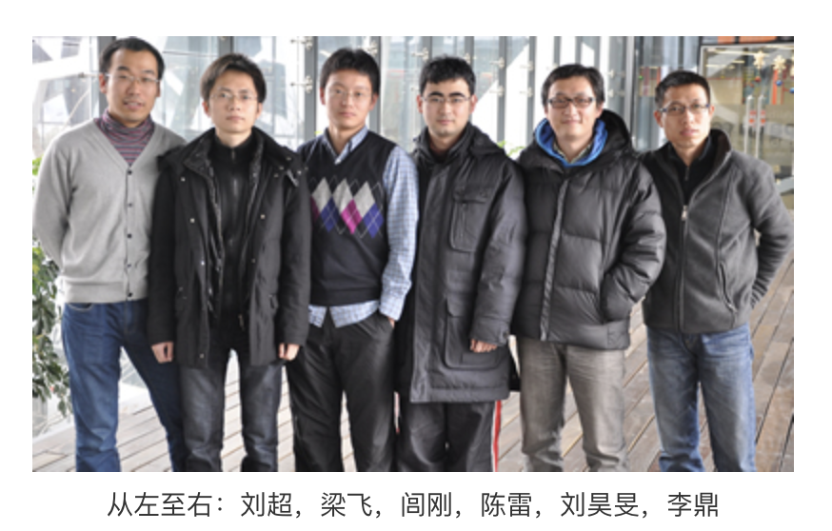
Dubbo History
Dubbo Team
2011
Version=2.5.3
PPT模板下载：www.1ppt.com/moban/ 行业PPT模板：www.1ppt.com/hangye/
节日PPT模板：www.1ppt.com/jieri/ PPT素材下载：www.1ppt.com/sucai/
PPT背景图片：www.1ppt.com/beijing/ PPT图表下载：www.1ppt.com/tubiao/
优秀PPT下载：www.1ppt.com/xiazai/ PPT教程： www.1ppt.com/powerpoint/
Word教程： www.1ppt.com/word/ Excel教程：www.1ppt.com/excel/
资料下载：www.1ppt.com/ziliao/ PPT课件下载：www.1ppt.com/kejian/
范文下载：www.1ppt.com/fanwen/ 试卷下载：www.1ppt.com/shiti/
教案下载：www.1ppt.com/jiaoan/ PPT论坛：www.1ppt.cn

Slide 4
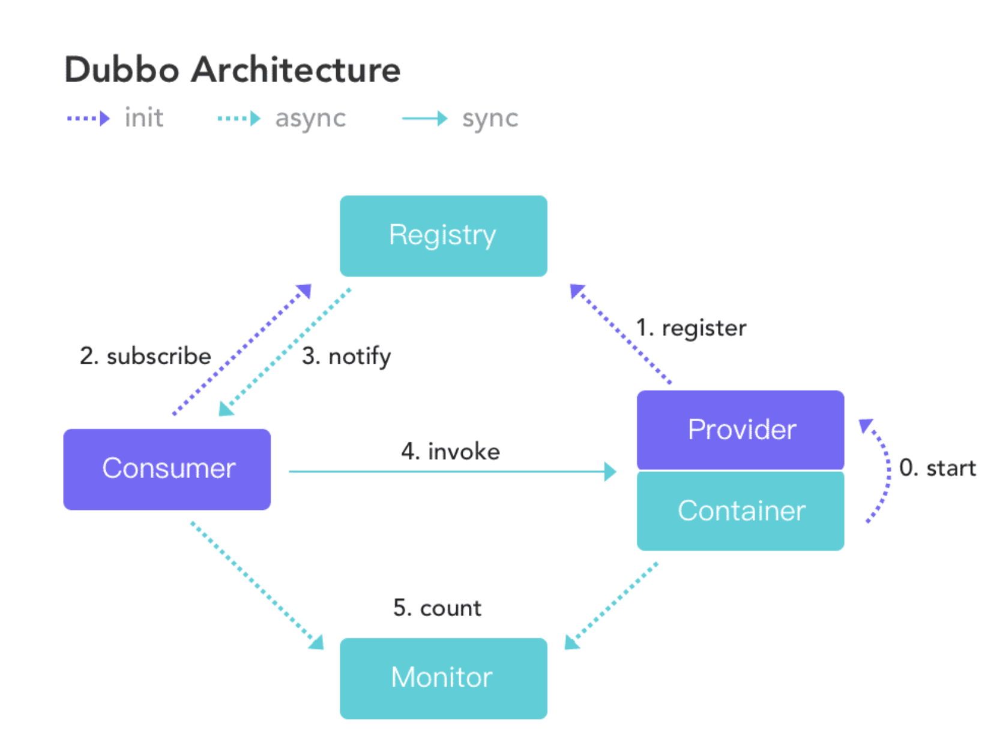
What is Dubbo?
Apache Dubbo (incubating) is a high-performance, java based, open source RPC framework.
PPT模板下载：www.1ppt.com/moban/ 行业PPT模板：www.1ppt.com/hangye/
节日PPT模板：www.1ppt.com/jieri/ PPT素材下载：www.1ppt.com/sucai/
PPT背景图片：www.1ppt.com/beijing/ PPT图表下载：www.1ppt.com/tubiao/
优秀PPT下载：www.1ppt.com/xiazai/ PPT教程： www.1ppt.com/powerpoint/
Word教程： www.1ppt.com/word/ Excel教程：www.1ppt.com/excel/
资料下载：www.1ppt.com/ziliao/ PPT课件下载：www.1ppt.com/kejian/
范文下载：www.1ppt.com/fanwen/ 试卷下载：www.1ppt.com/shiti/
教案下载：www.1ppt.com/jiaoan/ PPT论坛：www.1ppt.cn

Slide 5
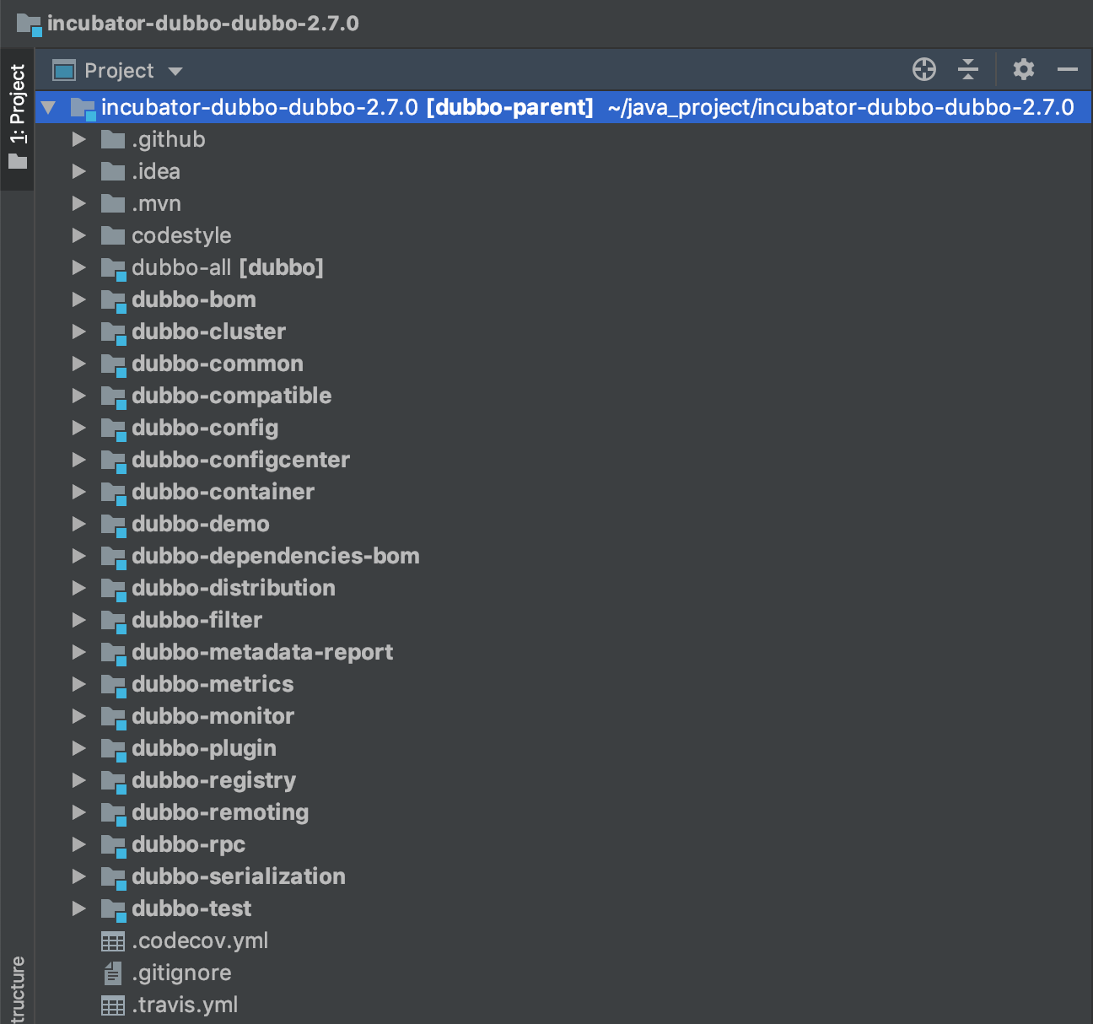
Dubbo Module
PPT模板下载：www.1ppt.com/moban/ 行业PPT模板：www.1ppt.com/hangye/
节日PPT模板：www.1ppt.com/jieri/ PPT素材下载：www.1ppt.com/sucai/
PPT背景图片：www.1ppt.com/beijing/ PPT图表下载：www.1ppt.com/tubiao/
优秀PPT下载：www.1ppt.com/xiazai/ PPT教程： www.1ppt.com/powerpoint/
Word教程： www.1ppt.com/word/ Excel教程：www.1ppt.com/excel/
资料下载：www.1ppt.com/ziliao/ PPT课件下载：www.1ppt.com/kejian/
范文下载：www.1ppt.com/fanwen/ 试卷下载：www.1ppt.com/shiti/
教案下载：www.1ppt.com/jiaoan/ PPT论坛：www.1ppt.cn

Slide 6
Dubbo Architecture
PPT模板下载：www.1ppt.com/moban/ 行业PPT模板：www.1ppt.com/hangye/
节日PPT模板：www.1ppt.com/jieri/ PPT素材下载：www.1ppt.com/sucai/
PPT背景图片：www.1ppt.com/beijing/ PPT图表下载：www.1ppt.com/tubiao/
优秀PPT下载：www.1ppt.com/xiazai/ PPT教程： www.1ppt.com/powerpoint/
Word教程： www.1ppt.com/word/ Excel教程：www.1ppt.com/excel/
资料下载：www.1ppt.com/ziliao/ PPT课件下载：www.1ppt.com/kejian/
范文下载：www.1ppt.com/fanwen/ 试卷下载：www.1ppt.com/shiti/
教案下载：www.1ppt.com/jiaoan/ PPT论坛：www.1ppt.cn

Slide 7
What are Dubbo?
Create stand-alone Spring applications
Embed Tomcat, Jetty or Undertow directly (no need to deploy WAR files)
Provide opinionated 'starter' dependencies to simplify your build configuration
Automatically configure Spring and 3rd party libraries whenever possible
Provide production-ready features such as metrics, health checks and externalized configuration
Absolutely no code generation and no requirement for XML configuration
PPT模板下载：www.1ppt.com/moban/ 行业PPT模板：www.1ppt.com/hangye/
节日PPT模板：www.1ppt.com/jieri/ PPT素材下载：www.1ppt.com/sucai/
PPT背景图片：www.1ppt.com/beijing/ PPT图表下载：www.1ppt.com/tubiao/
优秀PPT下载：www.1ppt.com/xiazai/ PPT教程： www.1ppt.com/powerpoint/
Word教程： www.1ppt.com/word/ Excel教程：www.1ppt.com/excel/
资料下载：www.1ppt.com/ziliao/ PPT课件下载：www.1ppt.com/kejian/
范文下载：www.1ppt.com/fanwen/ 试卷下载：www.1ppt.com/shiti/
教案下载：www.1ppt.com/jiaoan/ PPT论坛：www.1ppt.cn

Slide 8
What are Dubbo?
Create stand-alone Spring applications
Embed Tomcat, Jetty or Undertow directly (no need to deploy WAR files)
Provide opinionated 'starter' dependencies to simplify your build configuration
Automatically configure Spring and 3rd party libraries whenever possible
Provide production-ready features such as metrics, health checks and externalized configuration
Absolutely no code generation and no requirement for XML configuration
PPT模板下载：www.1ppt.com/moban/ 行业PPT模板：www.1ppt.com/hangye/
节日PPT模板：www.1ppt.com/jieri/ PPT素材下载：www.1ppt.com/sucai/
PPT背景图片：www.1ppt.com/beijing/ PPT图表下载：www.1ppt.com/tubiao/
优秀PPT下载：www.1ppt.com/xiazai/ PPT教程： www.1ppt.com/powerpoint/
Word教程： www.1ppt.com/word/ Excel教程：www.1ppt.com/excel/
资料下载：www.1ppt.com/ziliao/ PPT课件下载：www.1ppt.com/kejian/
范文下载：www.1ppt.com/fanwen/ 试卷下载：www.1ppt.com/shiti/
教案下载：www.1ppt.com/jiaoan/ PPT论坛：www.1ppt.cn

Slide 9


PPT模板下载：www.1ppt.com/moban/ 行业PPT模板：www.1ppt.com/hangye/
节日PPT模板：www.1ppt.com/jieri/ PPT素材下载：www.1ppt.com/sucai/
PPT背景图片：www.1ppt.com/beijing/ PPT图表下载：www.1ppt.com/tubiao/
优秀PPT下载：www.1ppt.com/xiazai/ PPT教程： www.1ppt.com/powerpoint/
Word教程： www.1ppt.com/word/ Excel教程：www.1ppt.com/excel/
资料下载：www.1ppt.com/ziliao/ PPT课件下载：www.1ppt.com/kejian/
范文下载：www.1ppt.com/fanwen/ 试卷下载：www.1ppt.com/shiti/
教案下载：www.1ppt.com/jiaoan/ PPT论坛：www.1ppt.cn

Slide 10

PPT模板下载：www.1ppt.com/moban/ 行业PPT模板：www.1ppt.com/hangye/
节日PPT模板：www.1ppt.com/jieri/ PPT素材下载：www.1ppt.com/sucai/
PPT背景图片：www.1ppt.com/beijing/ PPT图表下载：www.1ppt.com/tubiao/
优秀PPT下载：www.1ppt.com/xiazai/ PPT教程： www.1ppt.com/powerpoint/
Word教程： www.1ppt.com/word/ Excel教程：www.1ppt.com/excel/
资料下载：www.1ppt.com/ziliao/ PPT课件下载：www.1ppt.com/kejian/
范文下载：www.1ppt.com/fanwen/ 试卷下载：www.1ppt.com/shiti/
教案下载：www.1ppt.com/jiaoan/ PPT论坛：www.1ppt.cn

